Slide 1


UNODC GLOBAL MARITIME CRIME PROGRAMME (GMCP)
Development of Visit, Board, Search And Seizure (VBSS)
Curricula for the Sulu Zone
Dr Frank C. van Rooyen,
Security Institute for Governance and Leadership in Africa (SIGLA),
UNODC Consultant

Slide 2
VBSS Curricula Development for the Sulu Zone - Agenda
Aim
Framework of the VBSS consultancy
What is VBSS?
VBSS contextualised – From National/Regional Interests to its dynamics as part of maritime doctrine
Legal bases for VBSS interventions
Maritime Interdiction Operations (MIO) decision tree. Types and phases of VBSS missions
Unique elements of the Sulu Zone
Its impact on VBSS curricula development
Recommendations
Conclusions

Slide 3

Aim
This presentation has a twofold aim
Firstly, to give a generalised background to VBSS, how it fits into regional/national maritime security endeavours that attempt to achieve greater positive oceans governance; and what issues are required to plan, execute, and – when required – prosecute offenders
Then, with conference participants’ assistance, determine what issues would make VBSS training for the Sulu Zone different, even unique – to the extent that much more focused VBSS curricula are adapted and more focused on the region

Slide 4
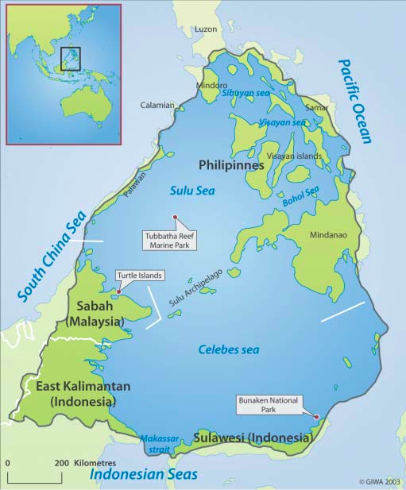
Framework for consultancy
Appointed via GMCP to develop a curriculum for VBSS training
Need to determine and factor in the unique requirements of the Sulu Zone (i.e. the Sulu and Celebes [or Sulawesi] Seas)
Appointed for 4 months (Aug to Nov 2018), 10 working days/month
Work from home, travel as required
Need to develop a further, specialised curriculum for the Boarding Officer (BO), in BO’s role as a maritime crime investigator, collecting and preparing cases for prosecution has become a requirement

Slide 5
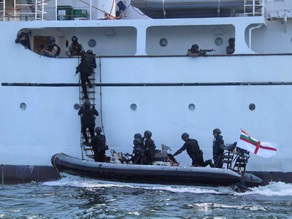
Briefly – what is VBSS?
Visit, Board, Search and Seizure (VBSS) is the term used by military and law enforcement agencies for maritime boarding actions and tactics. VBSS teams are mandated (through a range of legal mechanisms) to board contact-of-interest [COI](suspect, random or known) vessels, combat piracy, smuggling, conduct maritime crime and safety inspections, prevent or combat terrorism; as well as initiate and complete the prosecutorial train of action (as required)
VBSS operates at doctrinal level (i.e. “it’s the way we do things”, but remaining dynamic and flexible - not ossified - in thinking processes)

Slide 6
VBSS – Contextualised
National Interests
Global Environment
National Security Objectives
Domestic Environment
National Security Policy
Grand Strategy
Joint Military Strategy
Maritime Strategy
Landwards Strategy
Air Strategy
Space Strategy

Slide 7
Key Factors in Shaping the Maritime Military Strategy
Post-Cold War – an era of Violent Peace
Worldwide – growing dependency on the oceans and seas
Regional maritime geography. Countries have this resource, but countermined by need to protect and defend maritime interests
Supporting foreign policy:
  show presence, project power,
  facilitate maritime partnerships,
  build trust,
  create interoperability, and
  international maritime assistance
Ability to influence operations/events ashore
The cohesiveness of Joint Operations and the role of Air Power
Maritime Domain Awareness
Capability prioritization and development of National Maritime Infrastructure

Slide 8
Relation between Doctrine and Strategy
Remains a debatable issue, but following holds true for most nations/regions
Doctrine is evolved from government policies.
Strategy is derived from doctrine. If strategy brings success, it reinforces doctrine
If, however, it leads to failure, the doctrine is modified to achieve set-down national interests and objectives

Slide 9
Relationship between Policy, Doctrine & Strategy
Policy
Doctrine
Modify
Reinforce
Strategy
Failure
Result
Success

Slide 10
Jurisdiction: Legal bases that may be used to conduct VBSS missions (1)
According to best practice for maritime law enforcement, a State should have the following in place:
  Laws that assert its jurisidiction over specific activities/conduct in a specific maritime zone
  Laws that give its maritime law enforcement agencies the powers that are necessary to assert that jurisdiction (i.e. laws regarding boarding, detention, arrest, search and seizure) at sea; and
  Laws that allow its courts and other stakeholders in the criminal justice system to deal with such cases (even if they appear to fall outside the traditional limits of its territorial jurisdiction), through ensuring that the State’s relevant domestic laws have extraterritorial application.

Slide 11
Jurisdiction: Legal bases that may be used to conduct VBSS missions (2)
Note: Authorities’ use of these maritime law enforcement (MLE) are strictly limited to their purpose, must be precisely executed – exactly because they constitute a deviation from the general rule that exclusive jurisdiction is vested in the flag State of the vessel in question.
1. Flag State consent.
2. Coastal State jurisdiction (i.t.o. United Nations Convention of the Sea [UNCLOS, 1982] derived maritime zones)
3. National self-defence
4. United Nations Security Council (UNSC) Resolutions.
5. Pre-existing approvals based on treaties or agreements
6. The ‘right of visit’ i.t.o. UNCLOS Article 110
7. ‘The ship is engaged in piracy’
8. ‘The ship is engaged in the slave trade’
9. ‘The ship is engaged in illegal broadcasting’
10. ‘The ship is without nationality’
11. ‘Thought flying a foreign flag or refusing to show its flag, the ship is – in reality – of the same nationality as the [authorised] vessel.
Notes:
Chapter VII of the United Nations Charter sets out the UN Security Council's powers to maintain peace. It allows the Council to "determine the existence of any threat to the peace, breach of the peace, or act of aggression" and to take military and nonmilitary action to "restore international peace and security".

Slide 13
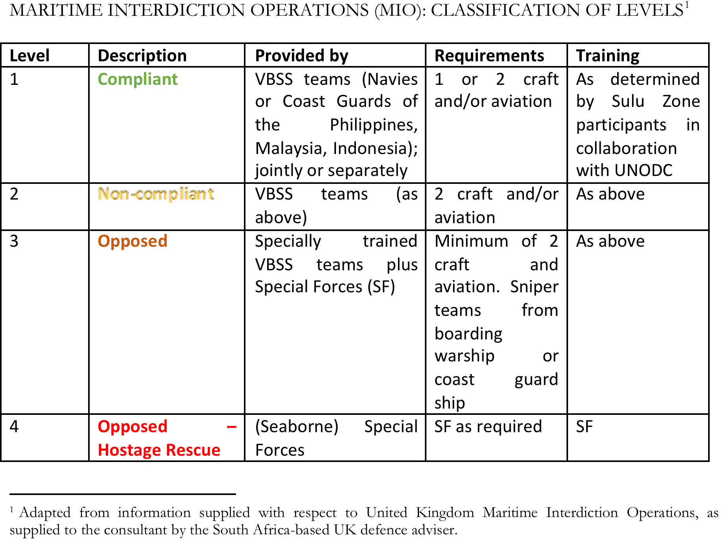

Slide 14
Attributes of the Sulu Zone:
Factors that influence VBSS training
Sulu Zone three countries: The Indonesia–Malaysia–Philippines Trilateral Maritime Patrol (Indomalphi) implemented its first joint patrol in June 2017, almost a year since signing the trilateral framework in August 2016
Geophysical properties: The Philippines, Indonesia, Malaysia
A notable summation of the geophysical and human interface by a publication of the United Nations Environment Programme (UNEP, 2005) accentuates the dynamic hazards and poor prognosis for the Sulu Zone should immediate and drastic intervention not be initiated or successfully managed
The peoples, historicities, piracy and maritime crime in the Sulu Zone
  Historical antecedents of many types of maritime crime over centuries gone
  As a generalised rule, much of the Sulu Zone populations show a scant regard for imposed national identity, seeking solace in the recognition of an own cultural, religious identity and historical lands
  To compound these complex issues, there are connections between maritime crime and terrorism in parts of Southeast Asia, including the Sulu Zone
Hence, there are associated and tangible challenges to governments of the Sulu Zone to pro-actively institute systems, doctrine and processes that ensure pro-active oceans governance on one hand, while ensuring the maintenance of human rights and associated cultural and traditional livelihood recognition on the other.

Slide 15
Summation: Sulu Zone VBSS training factors
Clearly, the greater the number of states and other critical stakeholders (including local populations), the greater the complexity of the VBSS training process. Accordingly, and stemming from the Sulu Zone evaluation, it is recommended that the follow training principles should be integrated into VBSS training:
1. Given the fact that the area comprises almost 22,000 islands - facilitates maritime crime, makes maritime crime routes unpredictable; immensely complex, and makes VBSS operations planning and execution a continuous challenge in terms of prevention and efficacy. In addition, this makes for porosity of (maritime) borders, so that inter-government cooperation in terms of ‘transgressions’ by other countries that may be perceived as intrusion into sovereign areas. INDOMALPHI-type cooperation is required
2. To dramatically underscore the issue of the undersea earthquakes, tsunamis, typhoons and tropical storms in the region – at the time of writing, more than 1,000 people have been killed in a powerful earthquake and resultant tsunami that struck the Indonesian island of Sulawesi. These types of dynamics need to be continuously factored into VBSS planning and execution, taking into account that VBSS missions may summarily be changed to become search and rescue or humanitarian operations, or indeed may - temporarily – become unsafe areas for maritime forces

Slide 16
Summation: Sulu Zone VBSS training factors
Thirdly, it would appear that the majority of the coastal populations in the Sulu Zone possess the following attributes: They tend to
be indigent, have daily struggles to maintain an economic grip on life, experience their seaborne livelihood as being under constant threat and diminishing, accordingly become economic migrants in search of better prospects, seemingly experience very little service delivery from governments, accordingly have little affinity for officialdom, likely identify and have affinity with groups that undermine government efforts (fifth columnists), comprise a vast number that are undocumented (that means few have national identification, even less have registered for passports), making their official movements an unknown factor; most probably regard government actions as intrusive (into their set and traditional ways of life) at the least.
Hence, a VBSS doctrine that does not include this knowledge to the planners and executors of VBSS would achieve opposite ends of the aim of achieving of oceans and seas pro-active governance; and would alienate and set the local population into oppositional ends, making VBSS doctrine redundant and self-defeating. In so far as this is feasible (event though it would extend implementation time-scales), the local population needs to be drawn into VBSS processes to ensure long-term inclusivity; so that the populace becomes an enduring part of the solution and does not contribute to the state of maritime insecurity and lawlessness that prevails.
Accordingly, this consultant highly recommends that a significant degree of sensitisation – directed towards heightened empathy with the condition of the local population – would need to be included in the training for Sulu Zone VBSS crews and their superiors. “Peace cannot be kept by force; it can only be achieved by understanding” – Albert Einstein. However, this training should be balanced by the fact that conditions – poverty, religious extremism, economic disenchantment, cultural priorities/lifestyles that are at variance with government priorities; and others – have driven a powerful minority into terrorism and maritime criminality; a risky situation that demands constant vigilance of the highest order in the Sulu Zone. Thus, the situation with respect to the local population makes it fraught with risk.

Slide 17
Summation: Sulu Zone VBSS training factors
Fourthly, inferred from the above assessment is the issue of language of instruction.
Finally – though not strictly within consultancy brief - it is important for the success of any VBSS planning and execution (and long-term Sulu Zone oceans and seas governance) that the command and control aspects be alluded to. Following principles supported:
  The three governments can follow the successes obtained in the Straits of Malacca ( ReCAAP and within ASEAN), together with the United Nations-authorised Task Forces (since 2008) and interventions (Sri Lanka, Seychelles) to combat maritime crime
  A composite inter-government maritime law and order coordination centre – a formalisation of the INDOMALPHI arrangement, informally also known as the ‘Sulu and Celebes Seas Contact Group – in the Sulu Zone should be established sooner rather than later. A common operational area needs to be defined and developed, command and control established. There appears to be much goodwill among the three nations in question
  Critically, resources need to be allocated (and continually budgeted for) to obtain (and upgrade/replace as required) state-of-the-art radar and information communications technology (ICT) that are fully integrated and compatible between the nations in question so that information-sharing occurs in real-time, where the example of ReCAAP can serve as a role model.
  In terms of training, simulation and modelling facilities: The UK’s Royal Navy and Royal Marines have excellent ‘ship in a box’ facillities at HMS DEFENDER, NATO has an optimised NMIOTC system in Souda Bay, Greek island of Crete; the USCG also has good facilities in Bahrain. These will be worthwhile places for the INDOMARPHIL maritime authorities to visit
it is submitted that these observations are valid and critical elements that ought to be fully incorporated into VBSS curricula designed for the Sulu Zone.

Slide 18
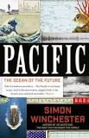
… and, lastly, read this book!

